Slide 1
What is Simple Linear Regression?
Simple linear regression is a statistical method that allows us to summarize and study relationships between two continuous (quantitative) variables:
One variable, denoted x, is regarded as the predictor, explanatory, or independent variable.
The other variable, denoted y, is regarded as the response, outcome, or dependent variable.
Simple linear regression gets its adjective "simple," because it concerns the study of only one predictor variable.
In contrast, multiple linear regression, gets its adjective "multiple," because it concerns the study of two or more predictor variables.

Slide 2
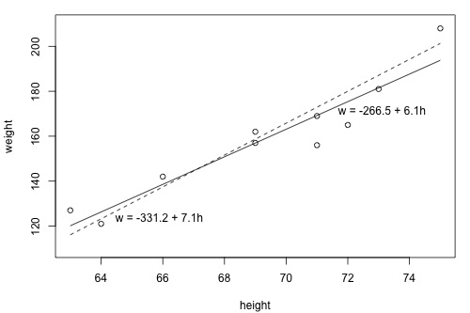
What is the "Best Fitting Line"?
Since we are interested in summarizing the trend between two quantitative variables, the natural question arises — "what is the best fitting line?“
Looking at the plot below, which line — the solid line or the dashed line — do you think best summarizes the trend between height and weight?
you can try it now on a set of heights (x) and weights (y) of 10 students, (student_height_weight.txt). Looking at the plot below, which line — the solid line or the dashed line — do you think best summarizes the trend between height and weight?

Slide 3
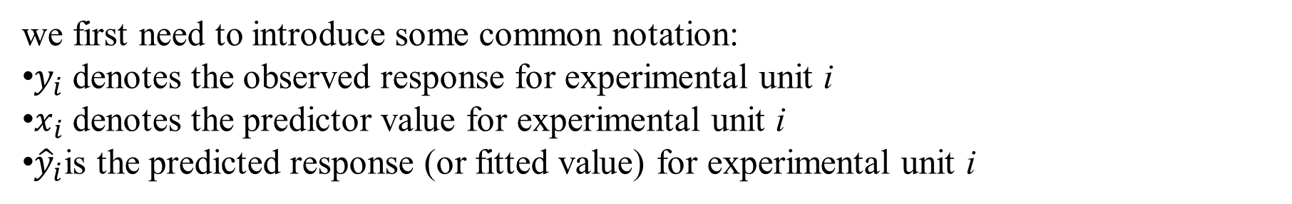
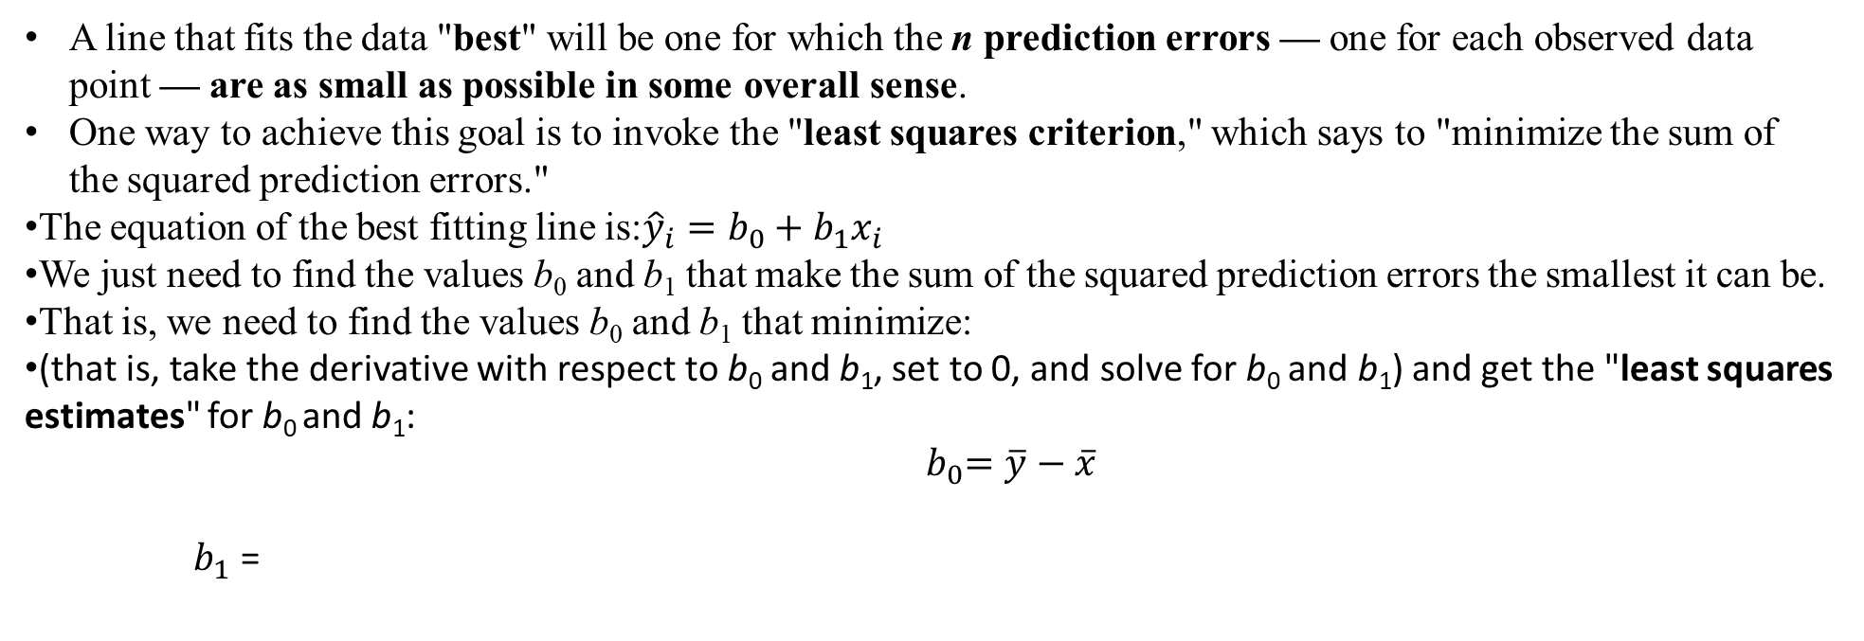
we first need to introduce some common notation:
$y_{i}$ denotes the observed response for experimental unit i
$x_{i}$ denotes the predictor value for experimental unit i
${\hat{y}}_{i}$is the predicted response (or fitted value) for experimental unit i
A line that fits the data "best" will be one for which the n prediction errors — one for each observed data point — are as small as possible in some overall sense.
One way to achieve this goal is to invoke the "least squares criterion," which says to "minimize the sum of the squared prediction errors."
The equation of the best fitting line is:${\hat{y}}_{i}=b_{0}+b_{1}x_{i}$
We just need to find the values b₀ and b₁ that make the sum of the squared prediction errors the smallest it can be.
That is, we need to find the values b₀ and b₁ that minimize:
(that is, take the derivative with respect to b₀ and b₁, set to 0, and solve for b₀ and b₁) and get the "least squares estimates" for b₀ and b₁:
$${ b}_{0}=\overline{y}−\overline{x}$$
$b_{1}$ =

Slide 4
Multiple linear regression
Multiple linear regression attempts to model the relationship between two or more features and a response by fitting a linear equation to observed data.
Clearly, it is nothing but an extension of Simple linear regression.
Consider a dataset with p features(or independent variables) and one response(or dependent variable). Also, the dataset contains n rows/observations.
We define regression equation as follows:-

Slide 5

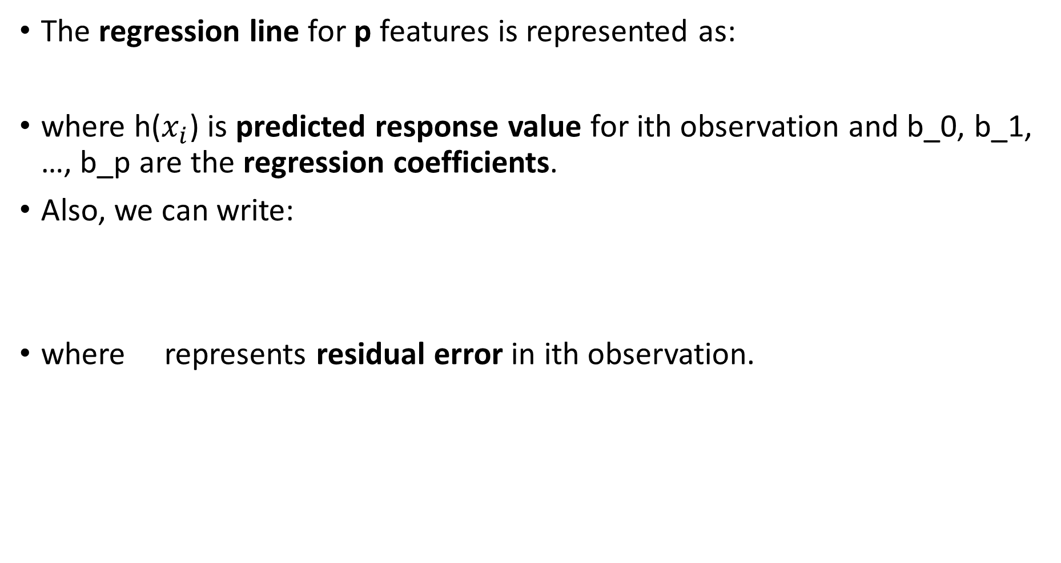
The regression line for p features is represented as:
where h($x_{i}$) is predicted response value for ith observation and b_0, b_1, …, b_p are the regression coefficients.
Also, we can write:
where represents residual error in ith observation.
Note: An increase of feature xk by one unit increases the prediction for y by βk units when all other feature values remain fixed.

Slide 6
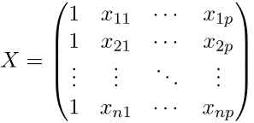
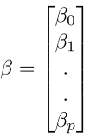
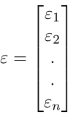
We can generalize our linear model a little bit more by representing feature matrix X as:
So now, the linear model can be expressed in terms of matrices as:
where,

Slide 7


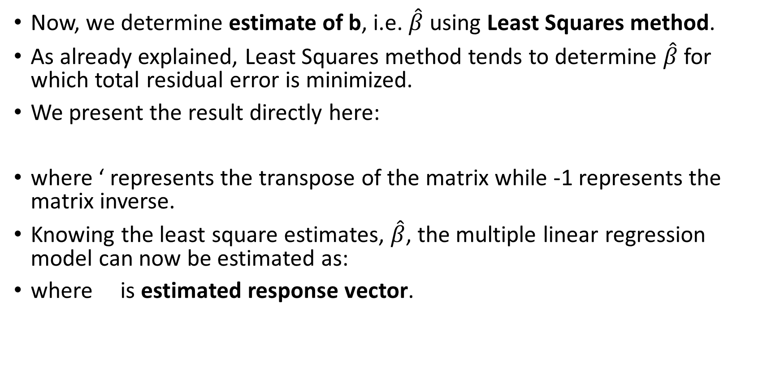
Now, we determine estimate of b, i.e. $\hat{β}$ using Least Squares method.
As already explained, Least Squares method tends to determine $\hat{β}$ for which total residual error is minimized.
We present the result directly here:
where ‘ represents the transpose of the matrix while -1 represents the matrix inverse.
Knowing the least square estimates, $\hat{β}$, the multiple linear regression model can now be estimated as:
where is estimated response vector.

Slide 8
Applications:
1. Trend lines: A trend line represents the variation in some quantitative data with passage of time (like GDP, oil prices, etc.).
These trends usually follow a linear relationship.
Hence, linear regression can be applied to predict future values.
However, this method suffers from a lack of scientific validity in cases where other potential changes can affect the data.
2. Economics: Linear regression is the predominant empirical tool in economics.
For example, it is used to predict consumption spending, fixed investment spending, inventory investment, purchases of a country’s exports, spending on imports, the demand to hold liquid assets, labor demand, and labor supply.
3. Finance: Capital price asset model uses linear regression to analyze and quantify the systematic risks of an investment.
4. Biology: Linear regression is used to model causal relationships between parameters in biological systems.

Slide 9
Generalized Linear Models
Linear Models in sklearn are a set of methods intended for regression in which the target value is expected to be a linear combination of the features. In mathematical notation, if y^ is the predicted value.
y^(w,x)=w0+w1x1+...+wpxp
Across the module, we designate the vector w=(w1,...,wp) as coef_ and
W0 as intercept_.
Programming Steps for Machine Learning
Read the physical data from secondary storage and label the feature Data as X and outcome data as y
To import the corresponding library we issue the command:
from sklearn import linear_model
Next we create LinearRegression object by issuing the following command:
reg = linear_model.LinearRegression()

Slide 10
Using Linear Regression from sklearn
Next step is to pass known X values and corresponding y values
In general the known X and y values are divided into two parts viz training part and test part in some ratio like 80:20, 75:25, etc
The algorithm is first trained with the given the training set with its known values
Then the values in the test part is given to the trained algorithm and values predicted by the trained algorithm are stored in some variables.
The predicted values from test part are compared with the known test values for finding the accuracy level.

Slide 11
sklearn.model_selection.train_test_split
Syntax: sklearn.model_selection.train_test_split(*arrays, **options)
Parameters:
*arrays : sequence of indexables with same length / shape[0]
Allowed inputs are lists, numpy arrays, scipy-sparse matrices or pandas dataframes.
test_size : float, int or None, optional (default=None)
If float, should be between 0.0 and 1.0 and represent the proportion of the dataset to include in the test split. If int, represents the absolute number of test samples. If None, the value is set to the complement of the train size. If train_size is also None, it will be set to 0.25.
train_size : float, int, or None, (default=None)
If float, should be between 0.0 and 1.0 and represent the proportion of the dataset to include in the train split. If int, represents the absolute number of train samples. If None, the value is automatically set to the complement of the test size.
random_state : int, RandomState instance or None, optional (default=None)
If int, random_state is the seed used by the random number generator; If RandomState instance, random_state is the random number generator; If None, the random number generator is the RandomState instance used by np.random.
shuffle : boolean, optional (default=True)
Whether or not to shuffle the data before splitting.

Slide 12
sklearn.model_selection.train_test_split
Examples:
X_train, X_test, y_train, y_test = train_test_split(X,y)
X_train, X_test, y_train, y_test = train_test_split(X,y, random_state=10)
X_train, X_test, y_train, y_test = train_test_split(X,y, random_state=20 test_size=.3)
X_train, X_test, y_train, y_test = train_test_split(X,y, random_state=13 test_size=10,train_size=20)

Slide 13
Fit method of Linear Regression
Syntax: fit(self, X, y, sample_weight=None)
Fits (i.e. trains) the linear model.
Parameters:
X : array-like or sparse matrix, shape (n_samples, n_features)
Training data
y : array_like, shape (n_samples, n_targets)
Target values. Will be cast to X’s dtype if necessary
sample_weight : numpy array of shape [n_samples]
Individual weights for each sample.

Slide 14
predict method of Linear Regression
Syntax: predict(self, X)
Predicts using the linear model
Parameters:
X : array_like or sparse matrix, shape (n_samples, n_features)
Samples.
Returns:
C : array, shape (n_samples,)
Returns predicted values.

Slide 15
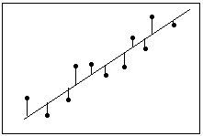
What Is Goodness-of-Fit for a Linear Model?
Linear regression calculates an equation that minimizes the distance between the fitted line and all of the data points. Technically, ordinary least squares (OLS) regression minimizes the sum of the squared residuals.
In general, a model fits the data well if the differences between the observed values and the model's predicted values are small.

Slide 16


R-squared
R-squared is a goodness-of-fit measure for linear regression models.
R-squared evaluates the scatter of the data points around the fitted regression line.
For the same data set, higher R-squared values represent smaller differences between the observed data and the fitted values.
R-squared is the percentage of the dependent variable variation that a linear model explains.

Slide 17
score method of Linear Regression
Syntax: score(self, X, y, sample_weight=None)
Returns the coefficient of determination R^2 of the prediction.
Parameters:
X : array-like, shape = (n_samples, n_features)
Test samples.
y : array-like, shape = (n_samples) or (n_samples, n_outputs)
True values for X.
sample_weight : array-like, shape = [n_samples], optional
Sample weights, if any.
Returns:
score : float
R^2 of predict(X) wrt. y.

Slide 18
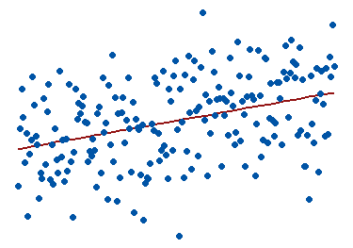
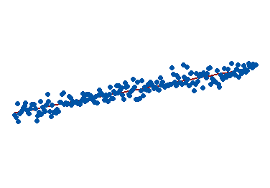
Visual Representation of R-squared
To visually demonstrate how R-squared values represent the scatter around the regression line, you can plot the fitted values by observed values.
The R-squared for the regression model on the left is 15%, and for the model on the right it is 85%.
When a regression model accounts for more of the variance, the data points are closer to the regression line.
In practice, you’ll never see a regression model with an R2 of 100%. In that case, the fitted values equal the data values and, consequently, all of the observations fall exactly on the regression line.

Slide 19
Explained Variance Score
We determine accuracy score using Explained Variance Score. We define:
explained_variance_score = 1 – Var{y – y’}/Var{y}
where y’ is the estimated target output, y the corresponding (correct) target output, and Var is Variance, the square of the standard deviation.
The best possible score is 1.0, lower values are worse.

Slide 20
Gradient Descent in Linear Regression
Gradient Descent is the process of minimizing a function by following the gradients of the cost function.
In linear regression, the model targets to get the best-fit regression line to predict the value of y based on the given input value (x).
This involves knowing the form of the cost as well as the derivative so that from a given point you know the gradient and can move in that direction, e.g. downhill towards the minimum value.
While training the model, the model calculates the cost function which measures the Root Mean Squared error between the predicted value (pred) and true value (y).
To minimize the cost function, the model needs to have the best value of θ₁ and θ₂.
Initially model selects θ₁ and θ₂ values randomly and then itertively update these value in order to minimize the cost function untill it reaches the minimum.
By the time model achieves the minimum cost function, it will have the best θ₁ and θ₂ values.
Using these finally updated values of θ₁ and θ₂ in the hypothesis equation of linear equation, model predicts the value of x in the best manner it can. Therefore, the question arises – How θ₁ and θ₂ values get updated ?

